Slide 1

US 1987-2006
Eren Batuhan Es – 3153944
Tulga Kagan Temel – 3168178
Doruk Efe Kanber – 3163051
In this slideshow, we examine the relationship between the short term interest rate and some determining variables in the United States between the years 1987 and 2006. Our data is on a quarterly basis, as we feel that it allows us to have enough data points to proceed with our analysis.

Slide 2
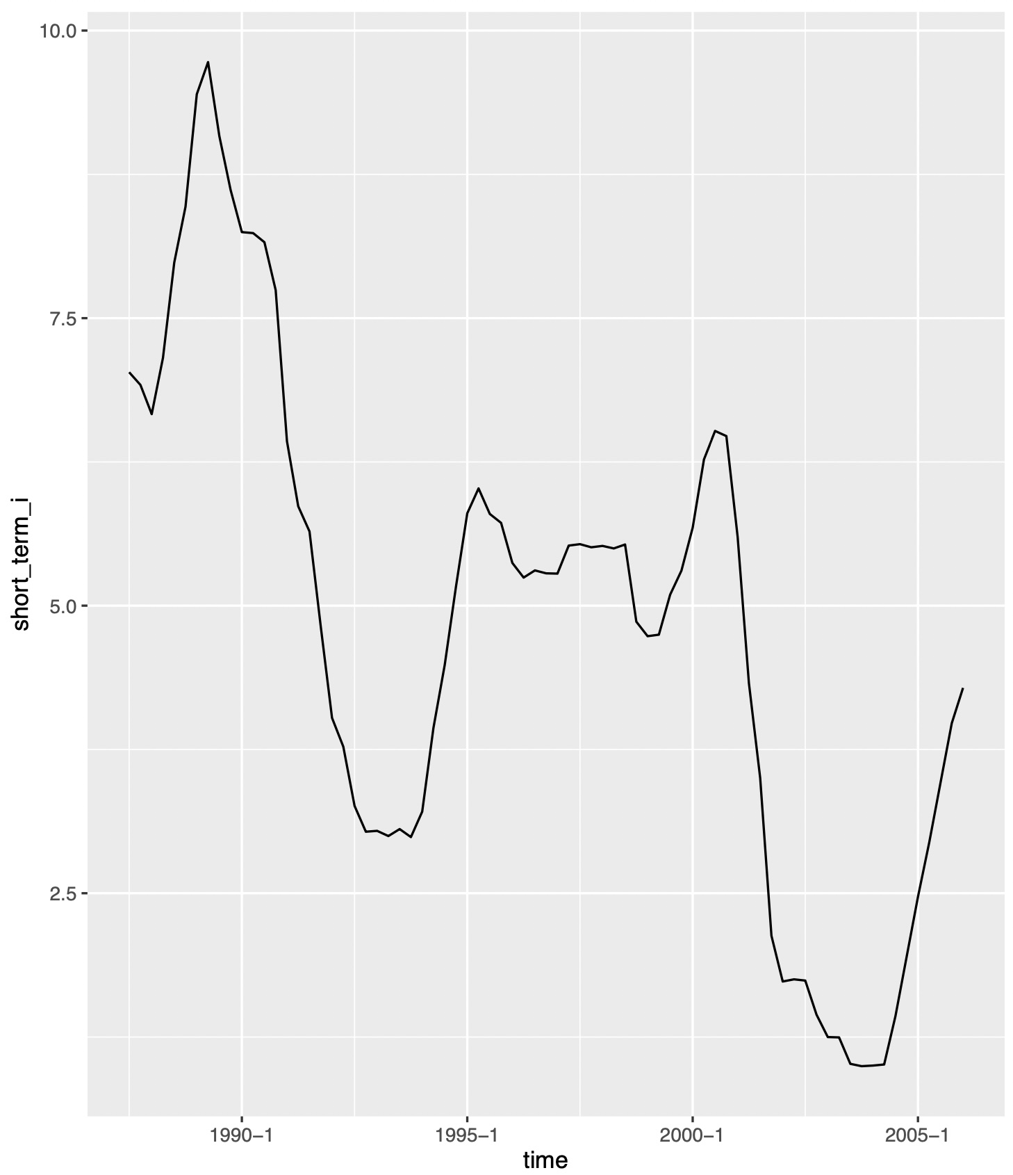

Short term interest rate’s trend (1987-2006)
The short-term nominal interest rate in the US included steep declines as well as steep rises in our observation period.
As shown in our graph, the rise in the interest rate around 1989 is followed by a decline from late 1989 until 1994, before recovering partially. It follows a relatively stable trend until 2000-Q4, where it drops one more time, reaching a minimum of 0,9967.
Immediately afterwards, it starts rising until the end of our observation period.

Slide 3
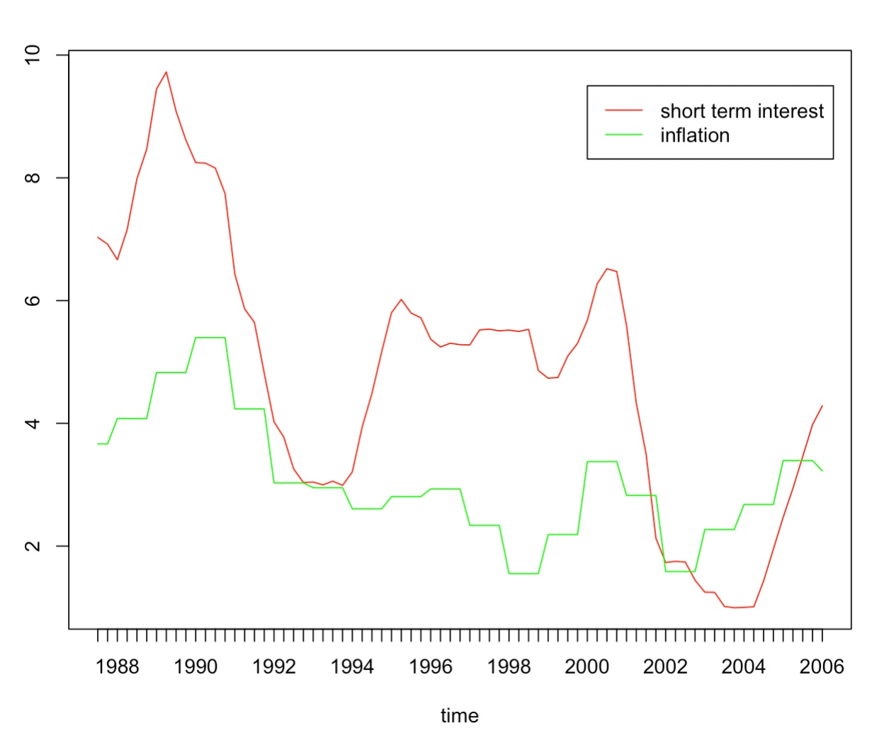
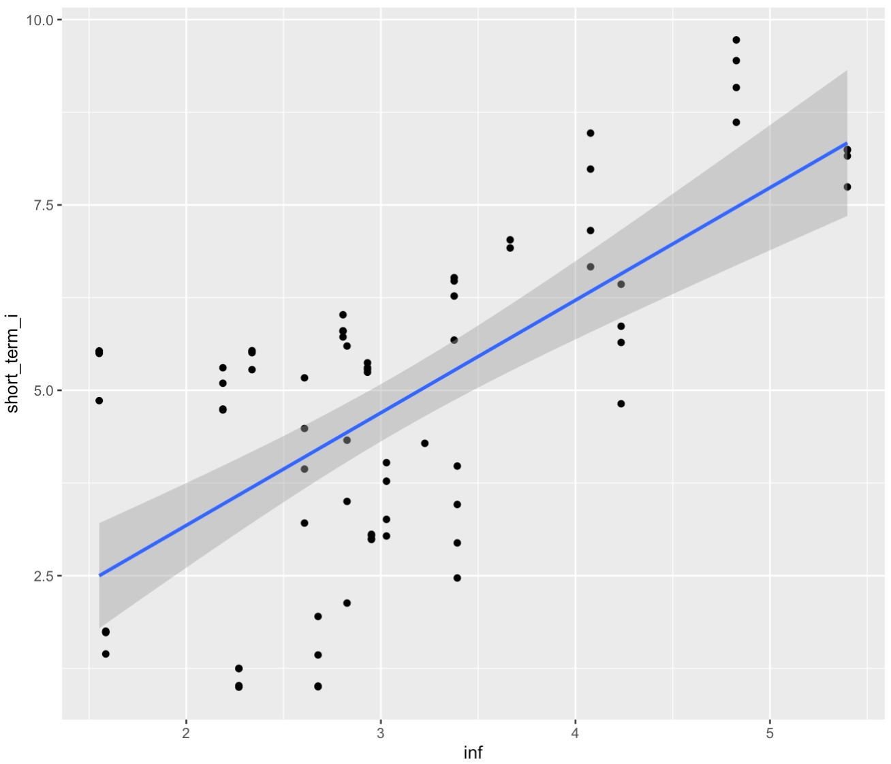
Interest rate and Inflation: empirical analysis
Our data suggest that inflation and short-term interest rate are positively correlated.
The graph above plots the interest rates and inflation over time.
The graph below plots the inflation rates and the corresponding short term interest rates.

Slide 4


Taylor’s rule:
The taylor rule is a monetary policy targeting rule that computes the optimal federal funds rate based on the gap and between the desired (targeted) inflation rate and the actual inflation rate; and the output gap between the actual and natural output level. Where is the difference between the inflation and the target inflation and is the output gap.
We are going to determine the OLS estimators for the coefficients in the following slides.

Slide 5
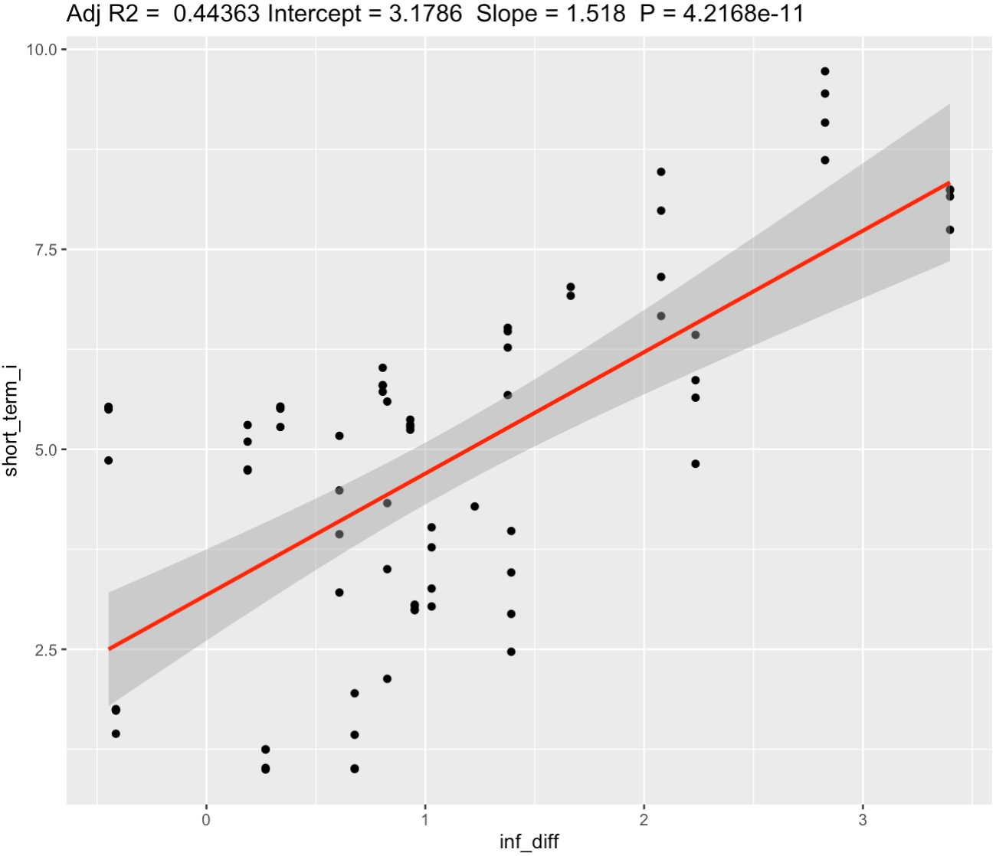
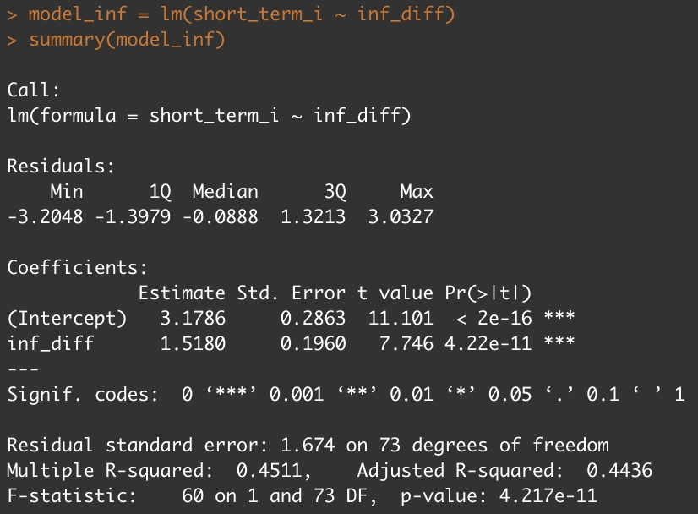
Introducing our first variable: inflation-target inflation
When we regress for (inflation-target inflation), we get the OLS estimates of its coefficient as 1.5180, which indicates that a unit of increase in inflation’s difference from the target will correspond to an increase of 1.5180 in the short-term interest rate. As we can see from our summary below, we reject the null hypothesis that the coefficient of the variable inf_diff is zero with a significance level lower than 1%.

Slide 6
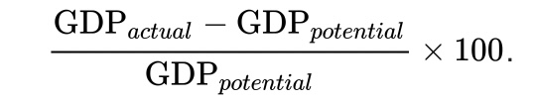
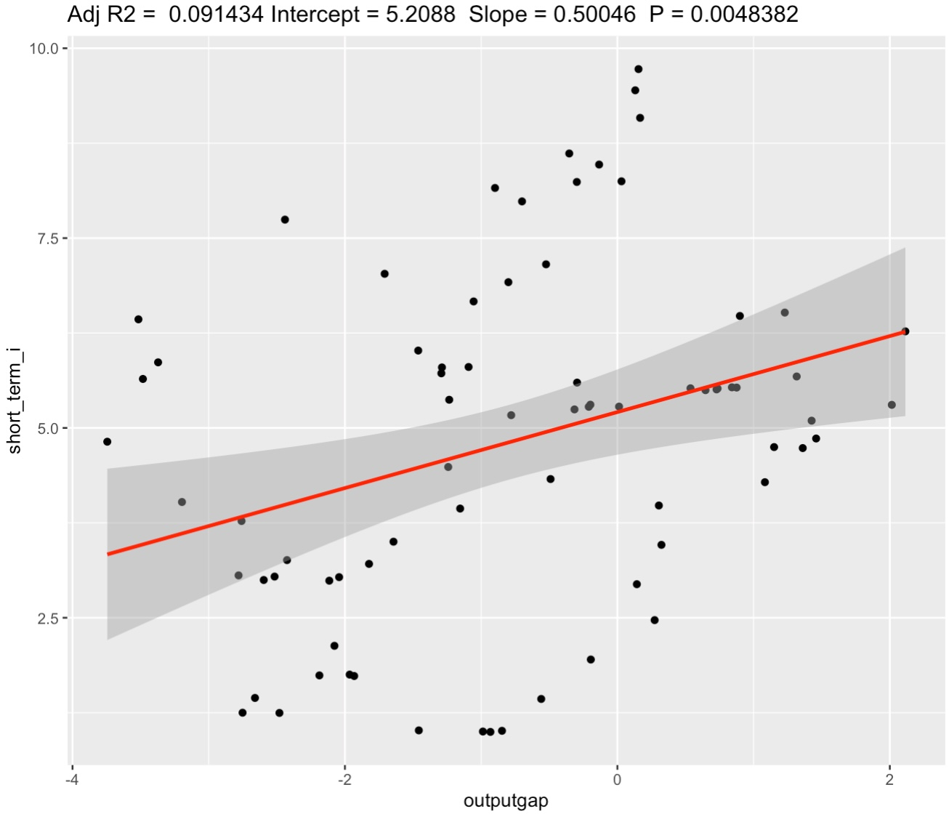
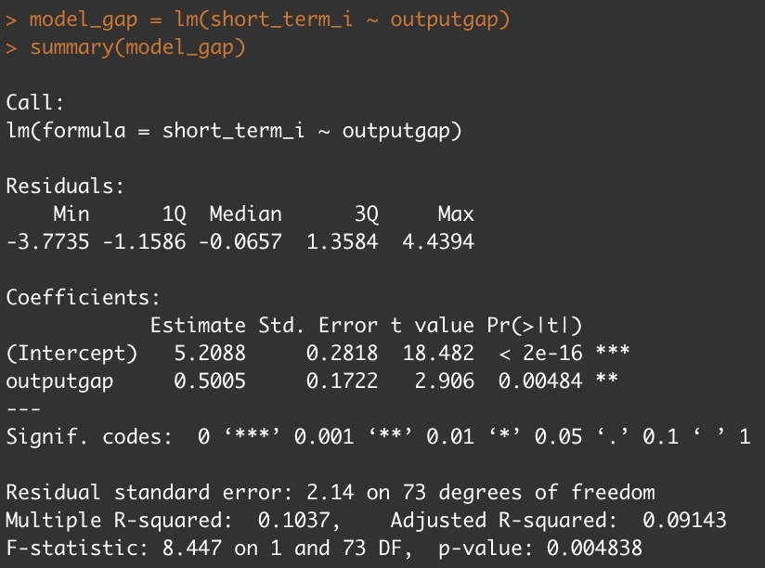
Introducing our second variable: output gap
When we regress for output gap, we get the OLS estimates of its coefficient as 0.5005, which indicates that a unit of increase in output gap will correspond to an increase of 0.5005 in the short-term interest rate. As we can see from our summary below, we reject the null hypothesis that the coefficient of the variable outputgap is zero with a significance level lower than 1%.

Slide 7
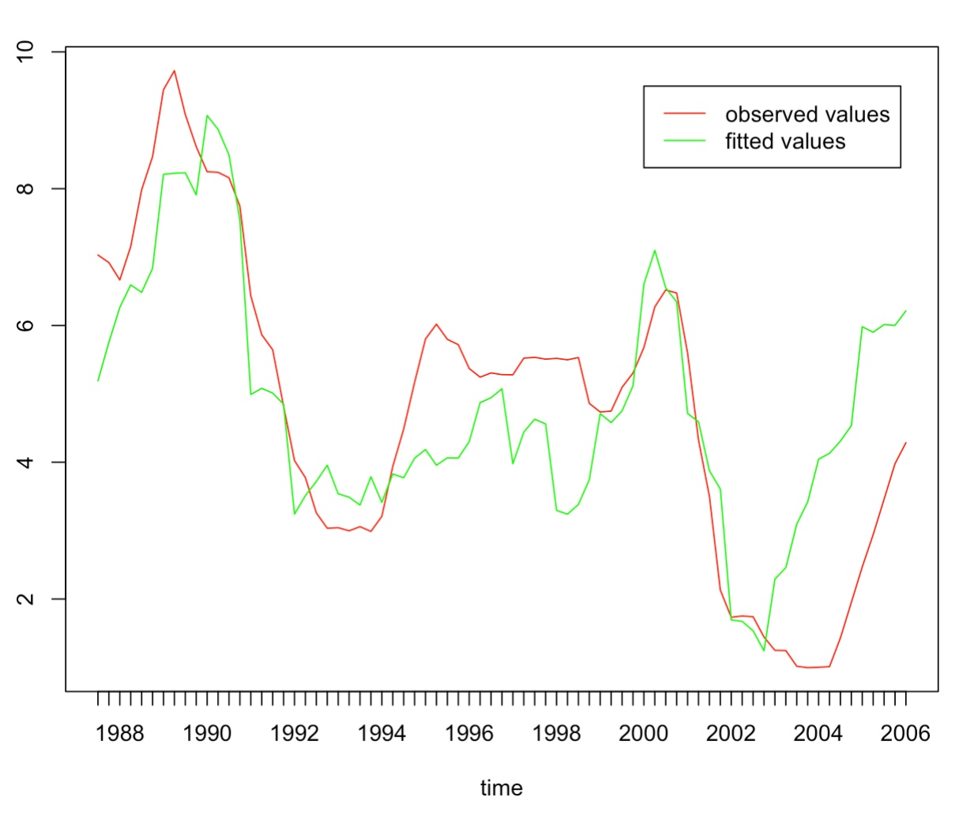
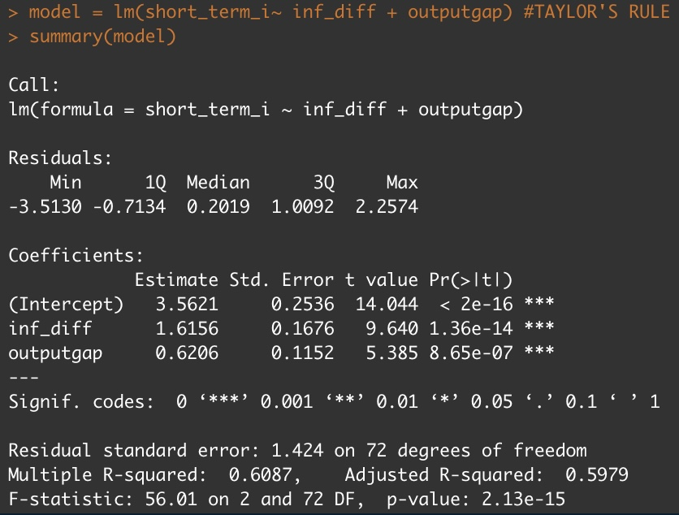
Two variables together: the Taylor model
When we regress for inflation difference and output gap together, we get the OLS estimates of the coefficients as 1.6156 and 0.6206, which indicate the change in short term interest following a unit of change in the corresponding variables. As we can see from our summary below, we reject the null hypothesis that the coefficients of the variables is zero with a significance level lower than 1%. (F-test)
Since we are dealing with time series data, our fitted values follow observed values pretty closely.
An R-Squared of 59.79% reveals that 59.79% of the variability observed in the target variable is explained in the regression model
Short term interest rate

Slide 8
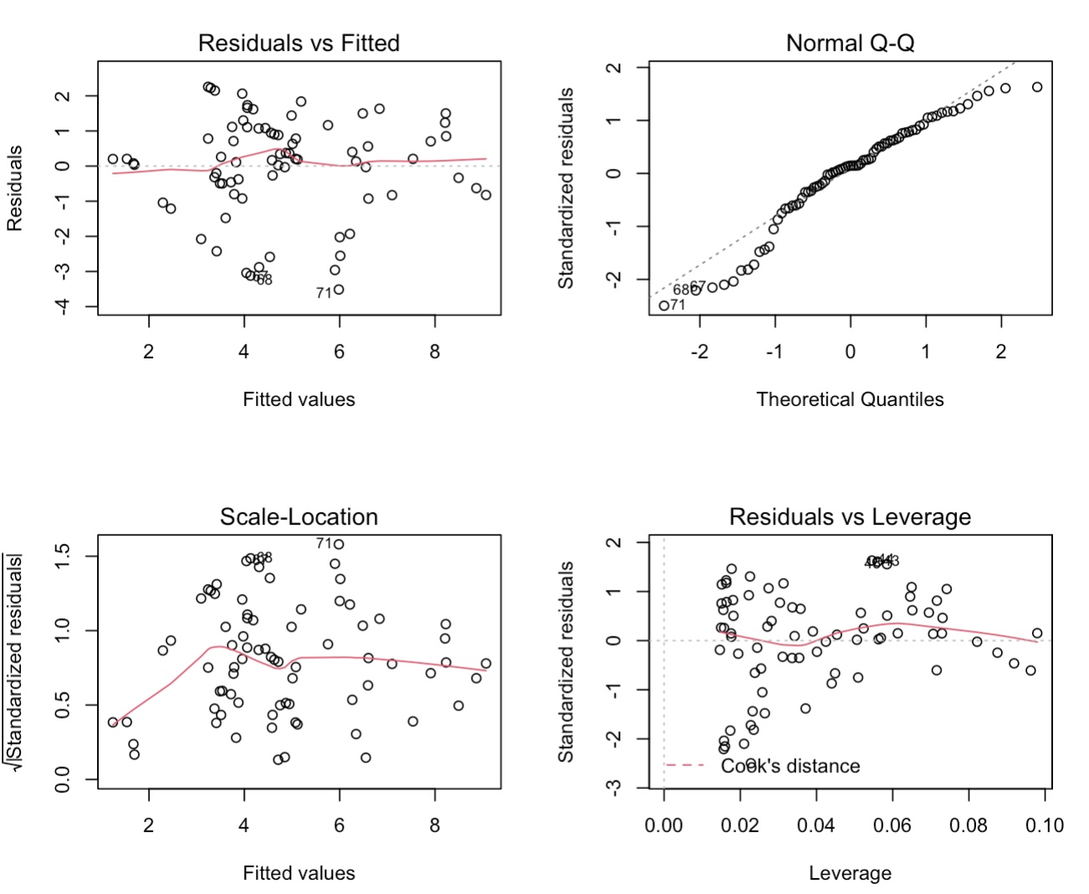
Diagnostic checks for the Taylor model:
Residuals seem normally distributed around 0. This suggests that the assumption that the relationship is linear is reasonable. We will rely on a RESET test for a better test of linearity.
The points in the Q-Q plot mostly lie on a straight diagonal line, apart from a curve in the beginning. The curve indicates that the residuals may not be normally distributed. We will rely on a Jarque-Bera test to better test for normality of residuals.
The Scale-Location graph measures if the residuals are homoscedastic or not. A straight horizontal red line implies homoscedastic residuals. Our graph has a steep incline on the left part of the graph, therefore we will rely on a Breusch Pagan test to better test for homoscedasticity.

Slide 9
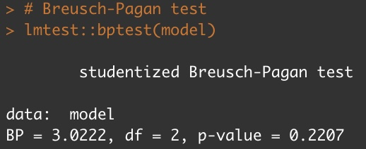
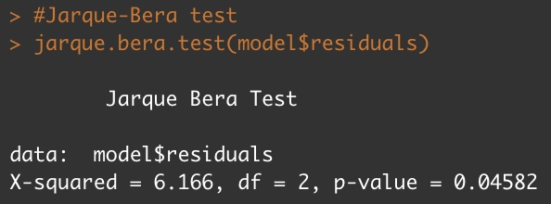
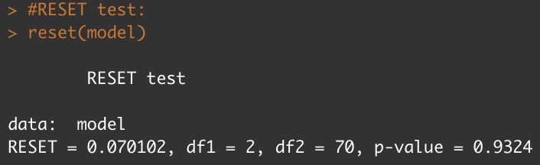
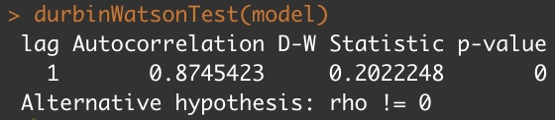
Other tests:
The Breusch Pagan tests the null hypothesis that the residuals are homoscedastic against the alternative that they are heteroscedastic. We can see that the p-value is 0.2207. We fail to reject the null hypothesis with a significance level of 5%. Therefore, we don’t have enough evidence to suggest that heteroscedasticity is present in this model.
The Jarque-Bera tests the null hypothesis that the residuals are normally distributed against the alternative that they are not. We can see that the p-value is 0.04582. We reject the null hypothesis with a significance level of 5%. Therefore, our model is likely to violate the normality assumption of errors.
The RESET tests the null hypothesis that the relationship is linear against the alternative that it isn’t. Our p-value is 0.9324, therefore we fail to reject the null hypothesis. Our model follows the linearity principle.
A p-value of 0 in the Durbin-Watson test means there is perfect autocorrelation. This will lead to inefficiency of the least squares estimates, which in turn will lead to wrong standard errors for the regression coefficient estimates and wrong t-statistics on the significance of the regression coefficients and misleading statistical inference based on a wrong estimate of the variance–covariance matrix computed under the assumption of no autocorrelation. Which makes sense since we are dealing with variables such as inflation and output whose higher values in period t will lead to relatively high biased ones in period t+1. This is also in line with how Robert Lucas criticized regressions about monetary policies, saying they can not be estimated using historical data since people’s expectations and reactions would be different.

Slide 10

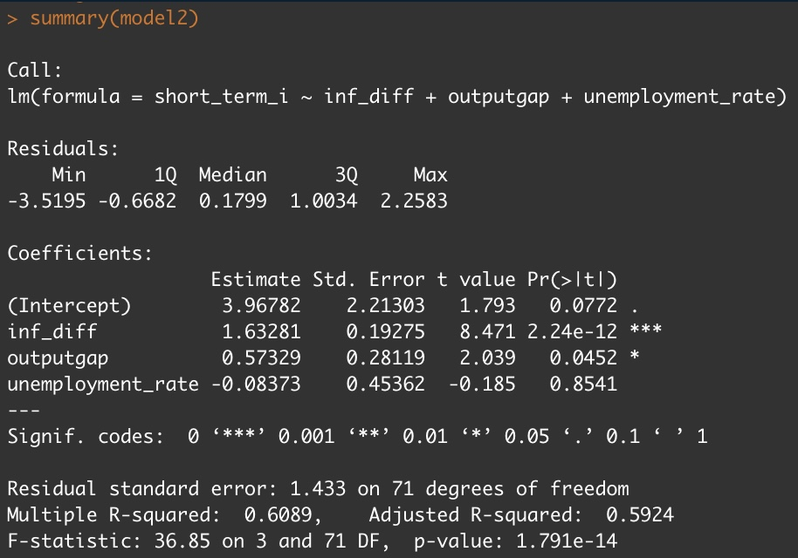
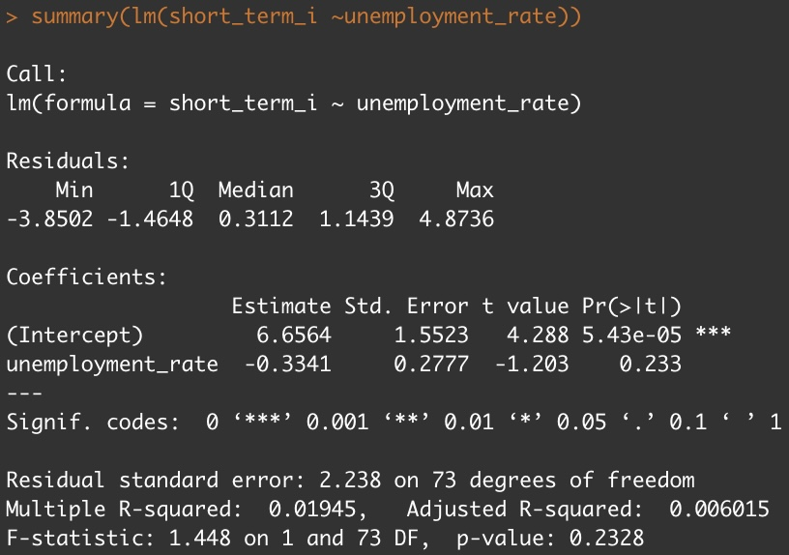
Adding other variables to the Taylor model: unemployment rate
Adding the variable unemployment rate to the Taylor model shows us that the unemployment rate is insignificant for our model. This is in line with the regression with unemployment rate as the only variable.
Unemployment rate also has a very strong negative correlation with output gap, which is another reason not to include it.

Slide 11

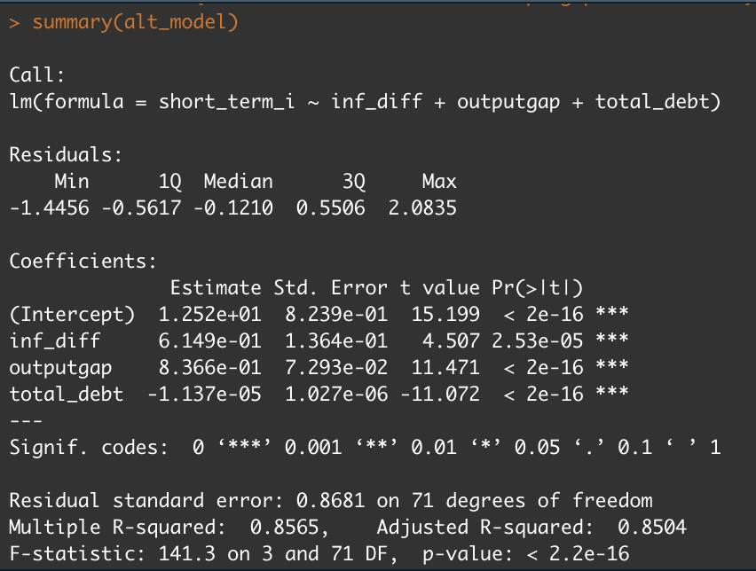
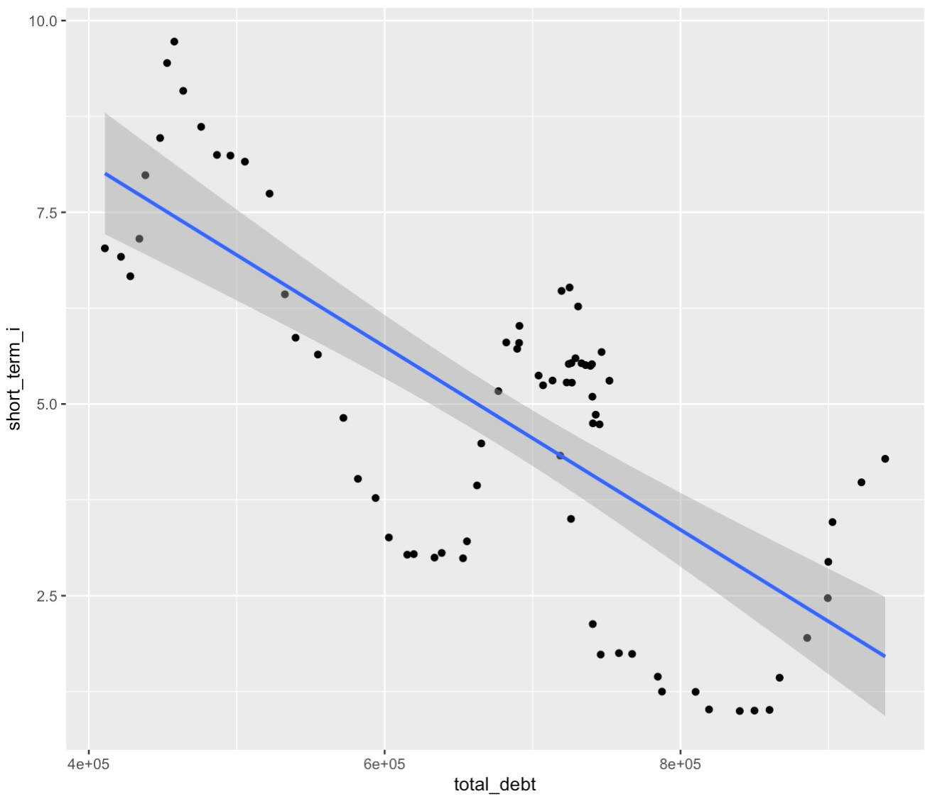
Adding other variables to the Taylor model: Debt
Adding the variable debt to the Taylor model, our regression demonstrates that all the variables are significant for our model.
However, total debt has a strong negative correlation with inflation-target inflation. This correlation is a problem because independent variables should be independent.

Slide 12
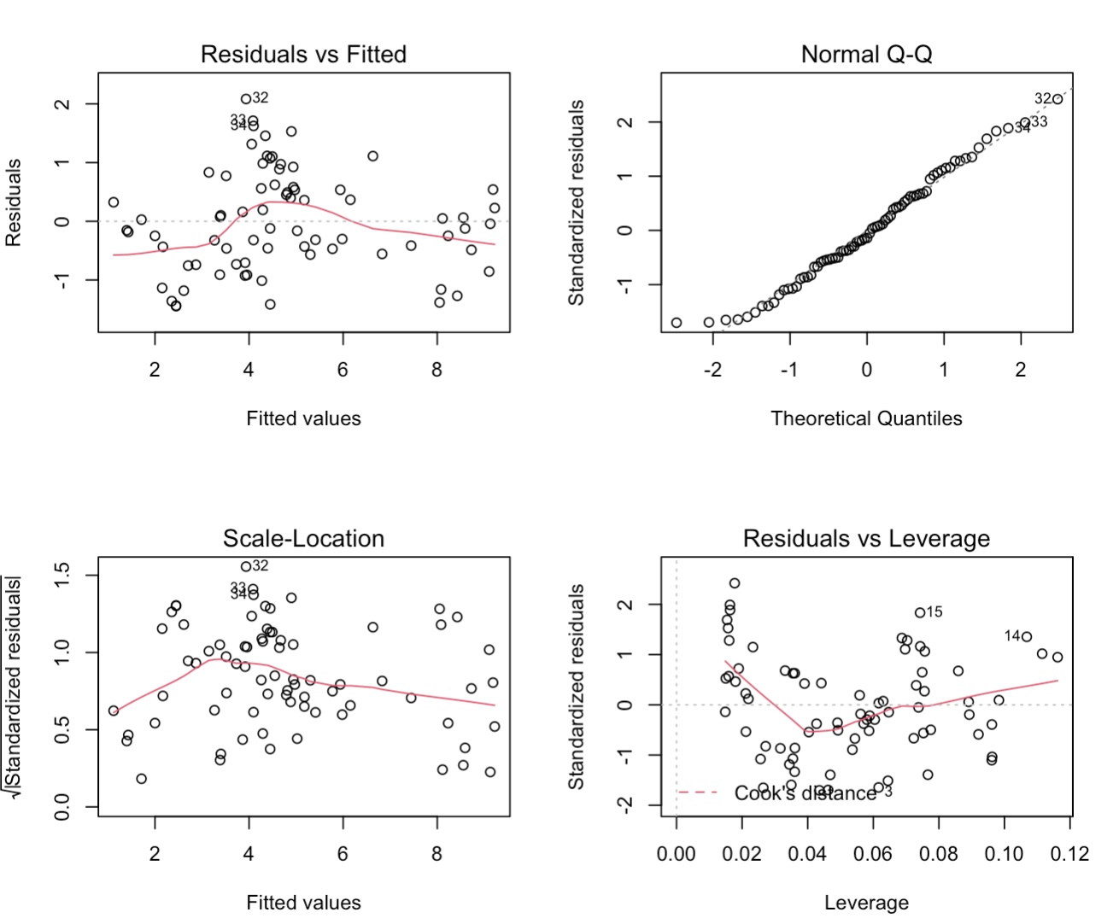
Adding other variables to the Taylor model: Debt
The linearity is in question. It looks like the non-linear relationship was left out in the residuals. We will check the RESET test in order to assess the linearity better.
The points in the Q-Q plot lie on a straight diagonal line. This implies that the residuals are normally distributed. We will check it with a Jarque-Bera test to better test for normality of residuals.
The Scale-Location graph measures if the residuals are homoscedastic or not. A straight horizontal red line implies homoscedastic residuals. Our graph has a steep incline on the left part of the graph, therefore we will rely on a Breusch Pagan test to better test for homoscedasticity.

Slide 13
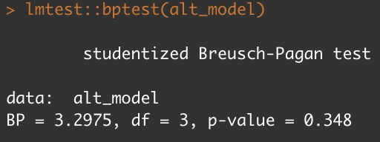
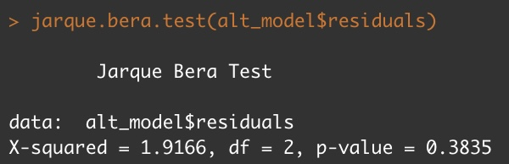
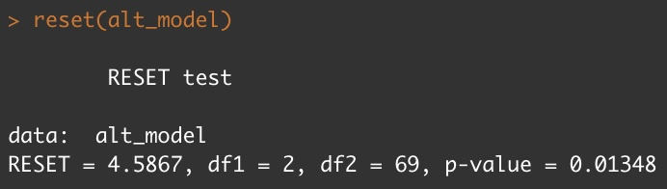
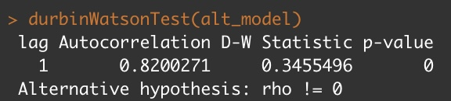
Other tests for the Taylor model + Debt
Our p-value for the Breusch Pagan is 0.348. Therefore, as with the Taylor model, we fail to reject the null hypothesis with a significance level of 5%. Therefore, we don’t have enough evidence to suggest that heteroscedasticity is present in this model.
The Jarque-Bera tests the null hypothesis that the residuals are normally distributed against the alternative that they are not. We can see that the p-value is 0.3835. We don’t reject the null hypothesis with a significance level of 5%.
The RESET tests the null hypothesis that the relationship is linear against the alternative that it isn’t. Our p-value is 0.01348, therefore we reject the null hypothesis. Our model follows a non-linear principle.
Just like the Taylor model, our p-value for the Durbin-Watson test is 0, which implies that there is perfect autocorrelation. The same problems arise.

Slide 14
Thank you!

